Slide 1

Atliq Hotel chain:
Revenue Insights and Analysis

Slide 2

Hello!
In this project, I delved into the revenue dynamics of a hotel chain, transforming raw data into actionable insights. By connecting Excel data to Power BI, I crafted engaging visualizations and KPIs, including Revenue, RevPAR, and ADR. This analysis aimed to reveal performance trends and guide strategic decisions to boost revenue and optimize hotel operations

Slide 3
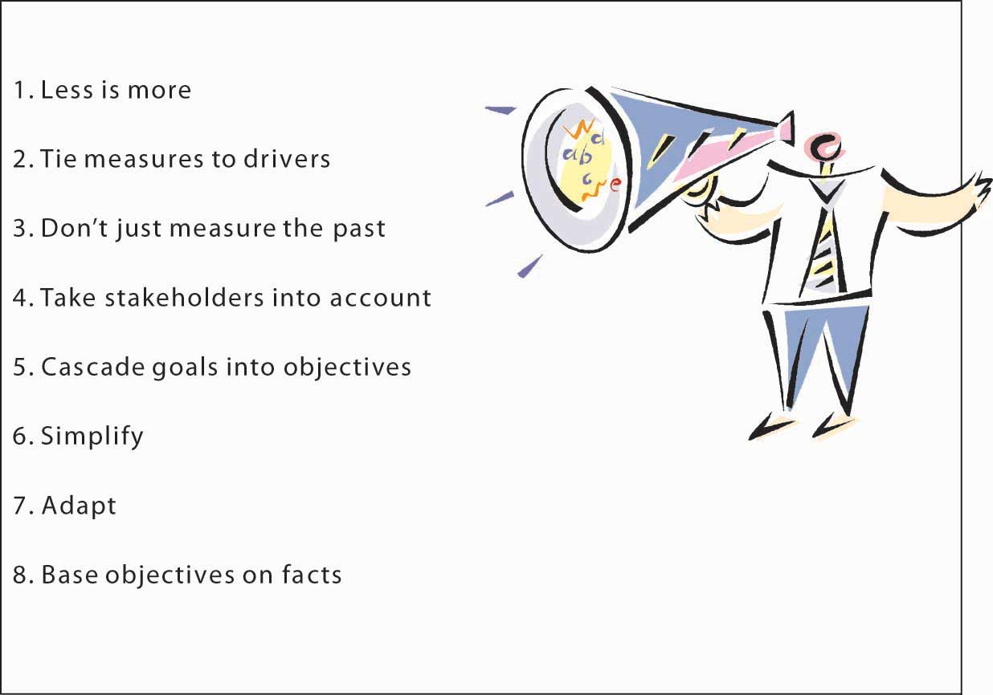
Objective:
Analyze Revenue Performance: Evaluate key metrics such as Revenue, RevPAR, ADR, and Occupancy% to understand overall hotel performance.
Identify Revenue Drivers: Discover factors that significantly influence revenue across different hotels and booking platforms.
Visualize Data Trends: Create visualizations to reveal trends and patterns in revenue and occupancy.
Compare Performance Across Regions: Assess and compare performance metrics by city to identify regional strengths and areas for improvement.
Guide Strategic Decisions: Provide actionable insights to optimize revenue strategies and enhance hotel operations.

Slide 4

Outcomes
Detailed Revenue Insights: Identified revenue trends and key performance metrics such as ADR, RevPAR, and Occupancy% across different hotels and booking platforms.
Performance Trends Uncovered: Revealed significant patterns in revenue and occupancy, including fluctuations by week and month.
Regional Performance Analysis: Highlighted differences in revenue and occupancy by city, identifying top-performing and underperforming locations.
Effective Visualization: Created clear and actionable visualizations, including graphs, doughnut charts, and line charts, to support data-driven decision-making.
Strategic Recommendations: Provided actionable insights and recommendations for optimizing revenue strategies and improving operational efficiency based on data analysis.

Slide 5
Power Bi Report:

Slide 6
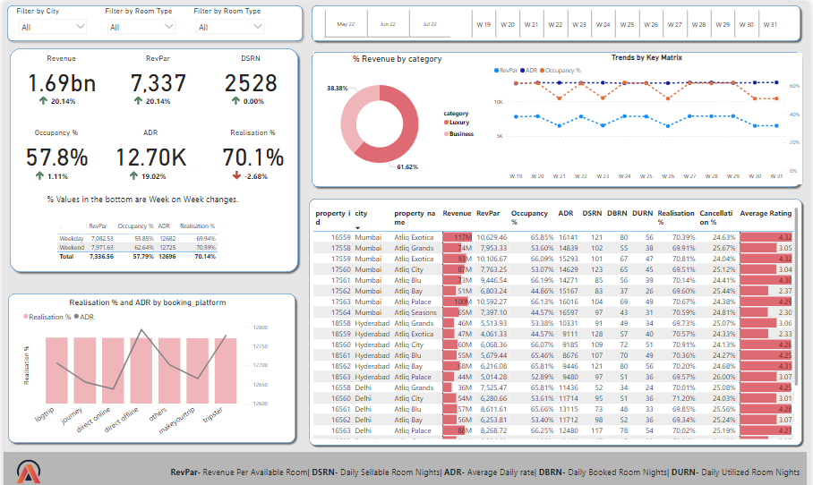

Slide 7

Insights:
Peak Revenue Performance: Revenue per Available Room (RevPAR) peaked in the 1st week of July, demonstrating the highest earning potential during this period before gradually declining. This indicates a strong performance at the beginning of the month and suggests the need for strategies to maintain momentum.
Occupancy Trends: Occupancy rates showed a decline in July and fluctuated significantly in May and June. This variability highlights the importance of understanding seasonal and monthly trends to better manage room availability and pricing.
Luxury vs. Business Revenue: The luxury category generated 61.6% of total revenue, while the business category contributed 38.4%. This disparity underscores the dominant role of luxury offerings in driving revenue and suggests focusing on enhancing luxury amenities to capture more market share.

Slide 8
Insights:
Impact of Hotel Ratings: A clear inverse relationship exists between hotel ratings and occupancy rates. Hotels with higher ratings tend to have better occupancy, while lower-rated properties experience reduced occupancy, emphasizing the need for continuous improvement in service quality.
Booking Platform Effectiveness: Revenue distribution indicates that other booking platforms are the most significant revenue sources, whereas offline bookings contribute minimally. Leveraging digital and online booking channels more effectively could boost overall revenue.
Regional Revenue Variations: Delhi reported the lowest revenue, whereas Mumbai achieved the highest revenue. This geographical variance highlights the necessity for tailored regional strategies to address local market dynamics and optimize performance in underperforming areas.

Slide 9

Recommendations:
Adopt and Monitor Dynamic Pricing: Implement and regularly adjust dynamic pricing based on occupancy trends, weekdays, and seasonal demand to optimize revenue.
Enhance Luxury Services: Expand luxury amenities to capitalize on high revenue from this segment.
Improve Service Quality: Invest in service enhancements to boost ratings and increase occupancy. Higher ratings lead to increased occupancy rates and improved guest satisfaction.
Boost Online Presence: Strengthen partnerships with online booking platforms to increase visibility and drive bookings.
Tailor Regional Strategies: Develop targeted marketing and operational strategies for underperforming regions like Delhi to enhance performance. Use localized marketing and promotions to address specific market needs and improve regional performance.

Slide 10
Thank you
As we wrap up this chapter of our journey, I want to express my gratitude for your time and attention. Thank you for reviewing this analysis of the Atliq hotel chain’s revenue data. I appreciate your time and consideration of the insights and recommendations provided. I look forward to any questions or feedback you may have and am eager to discuss further strategies to enhance performance and achieve our goals.

